Slide 1

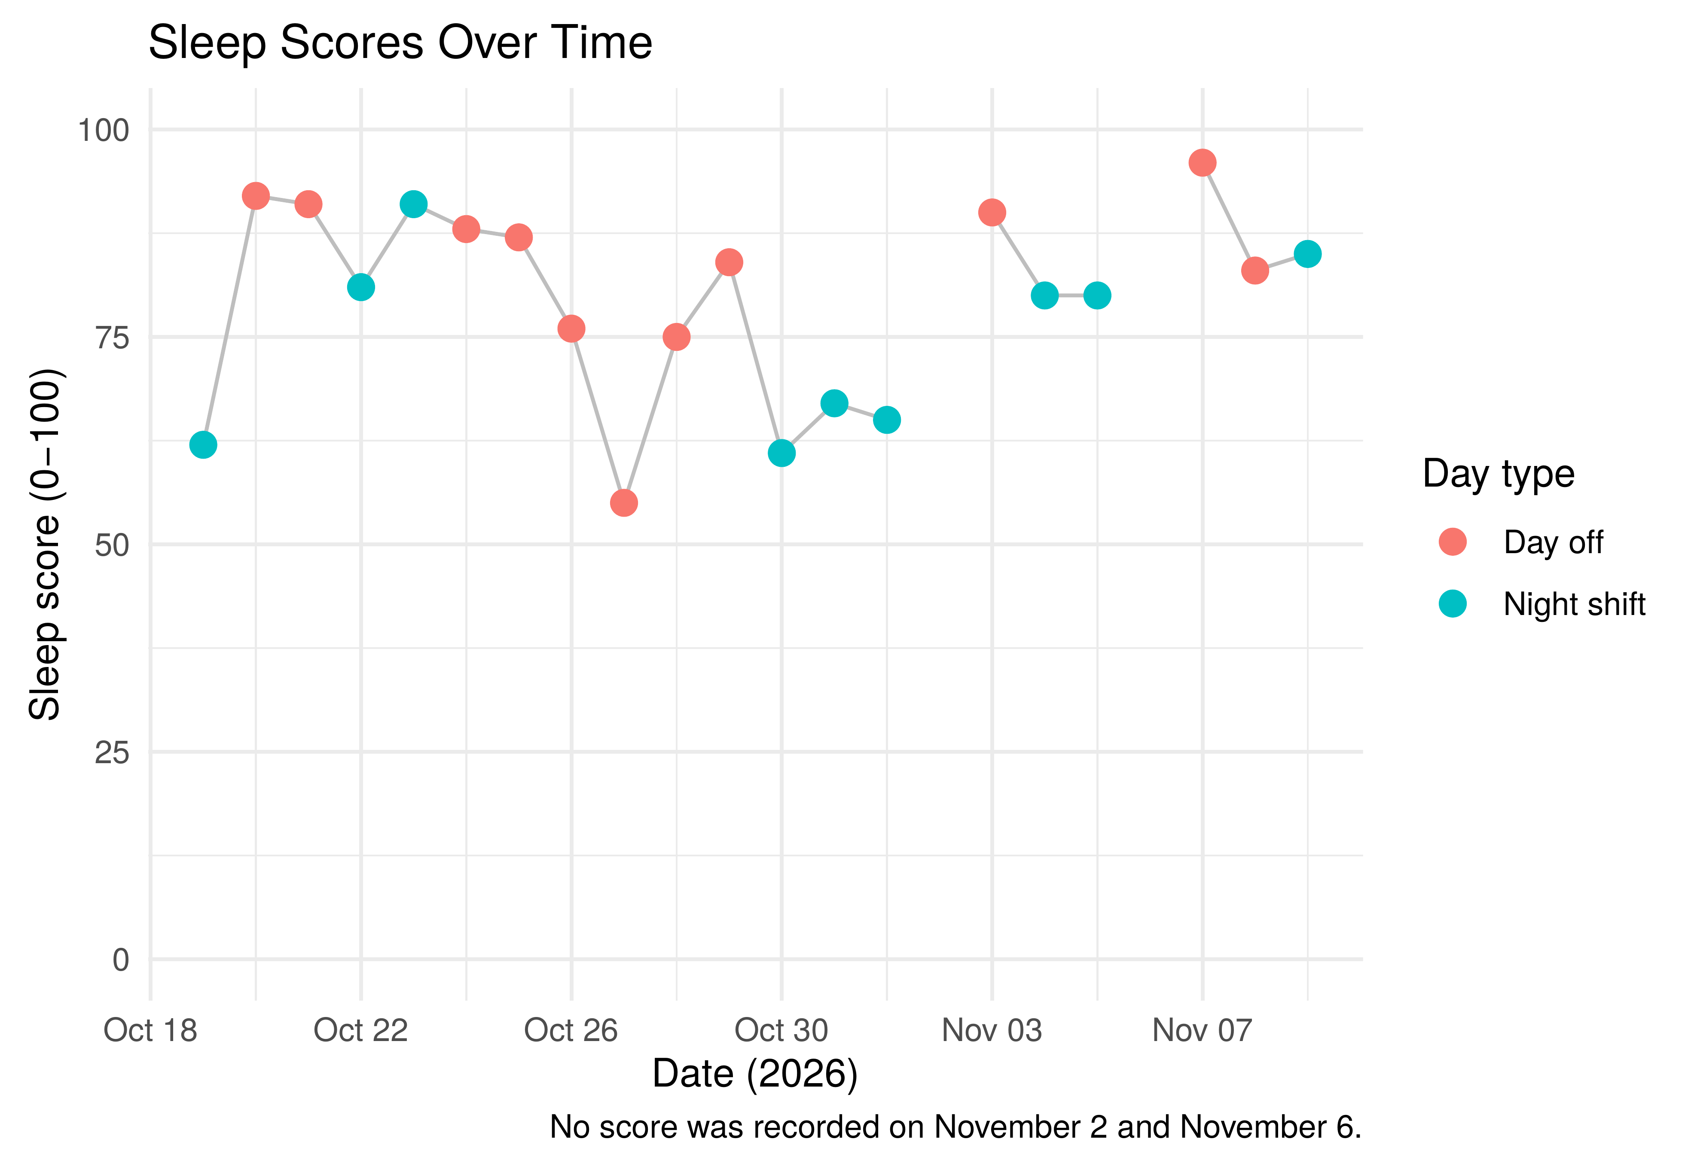
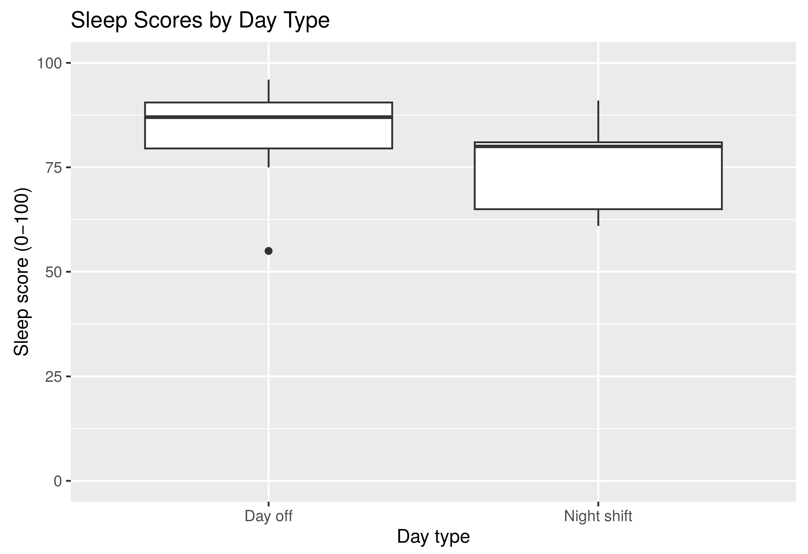
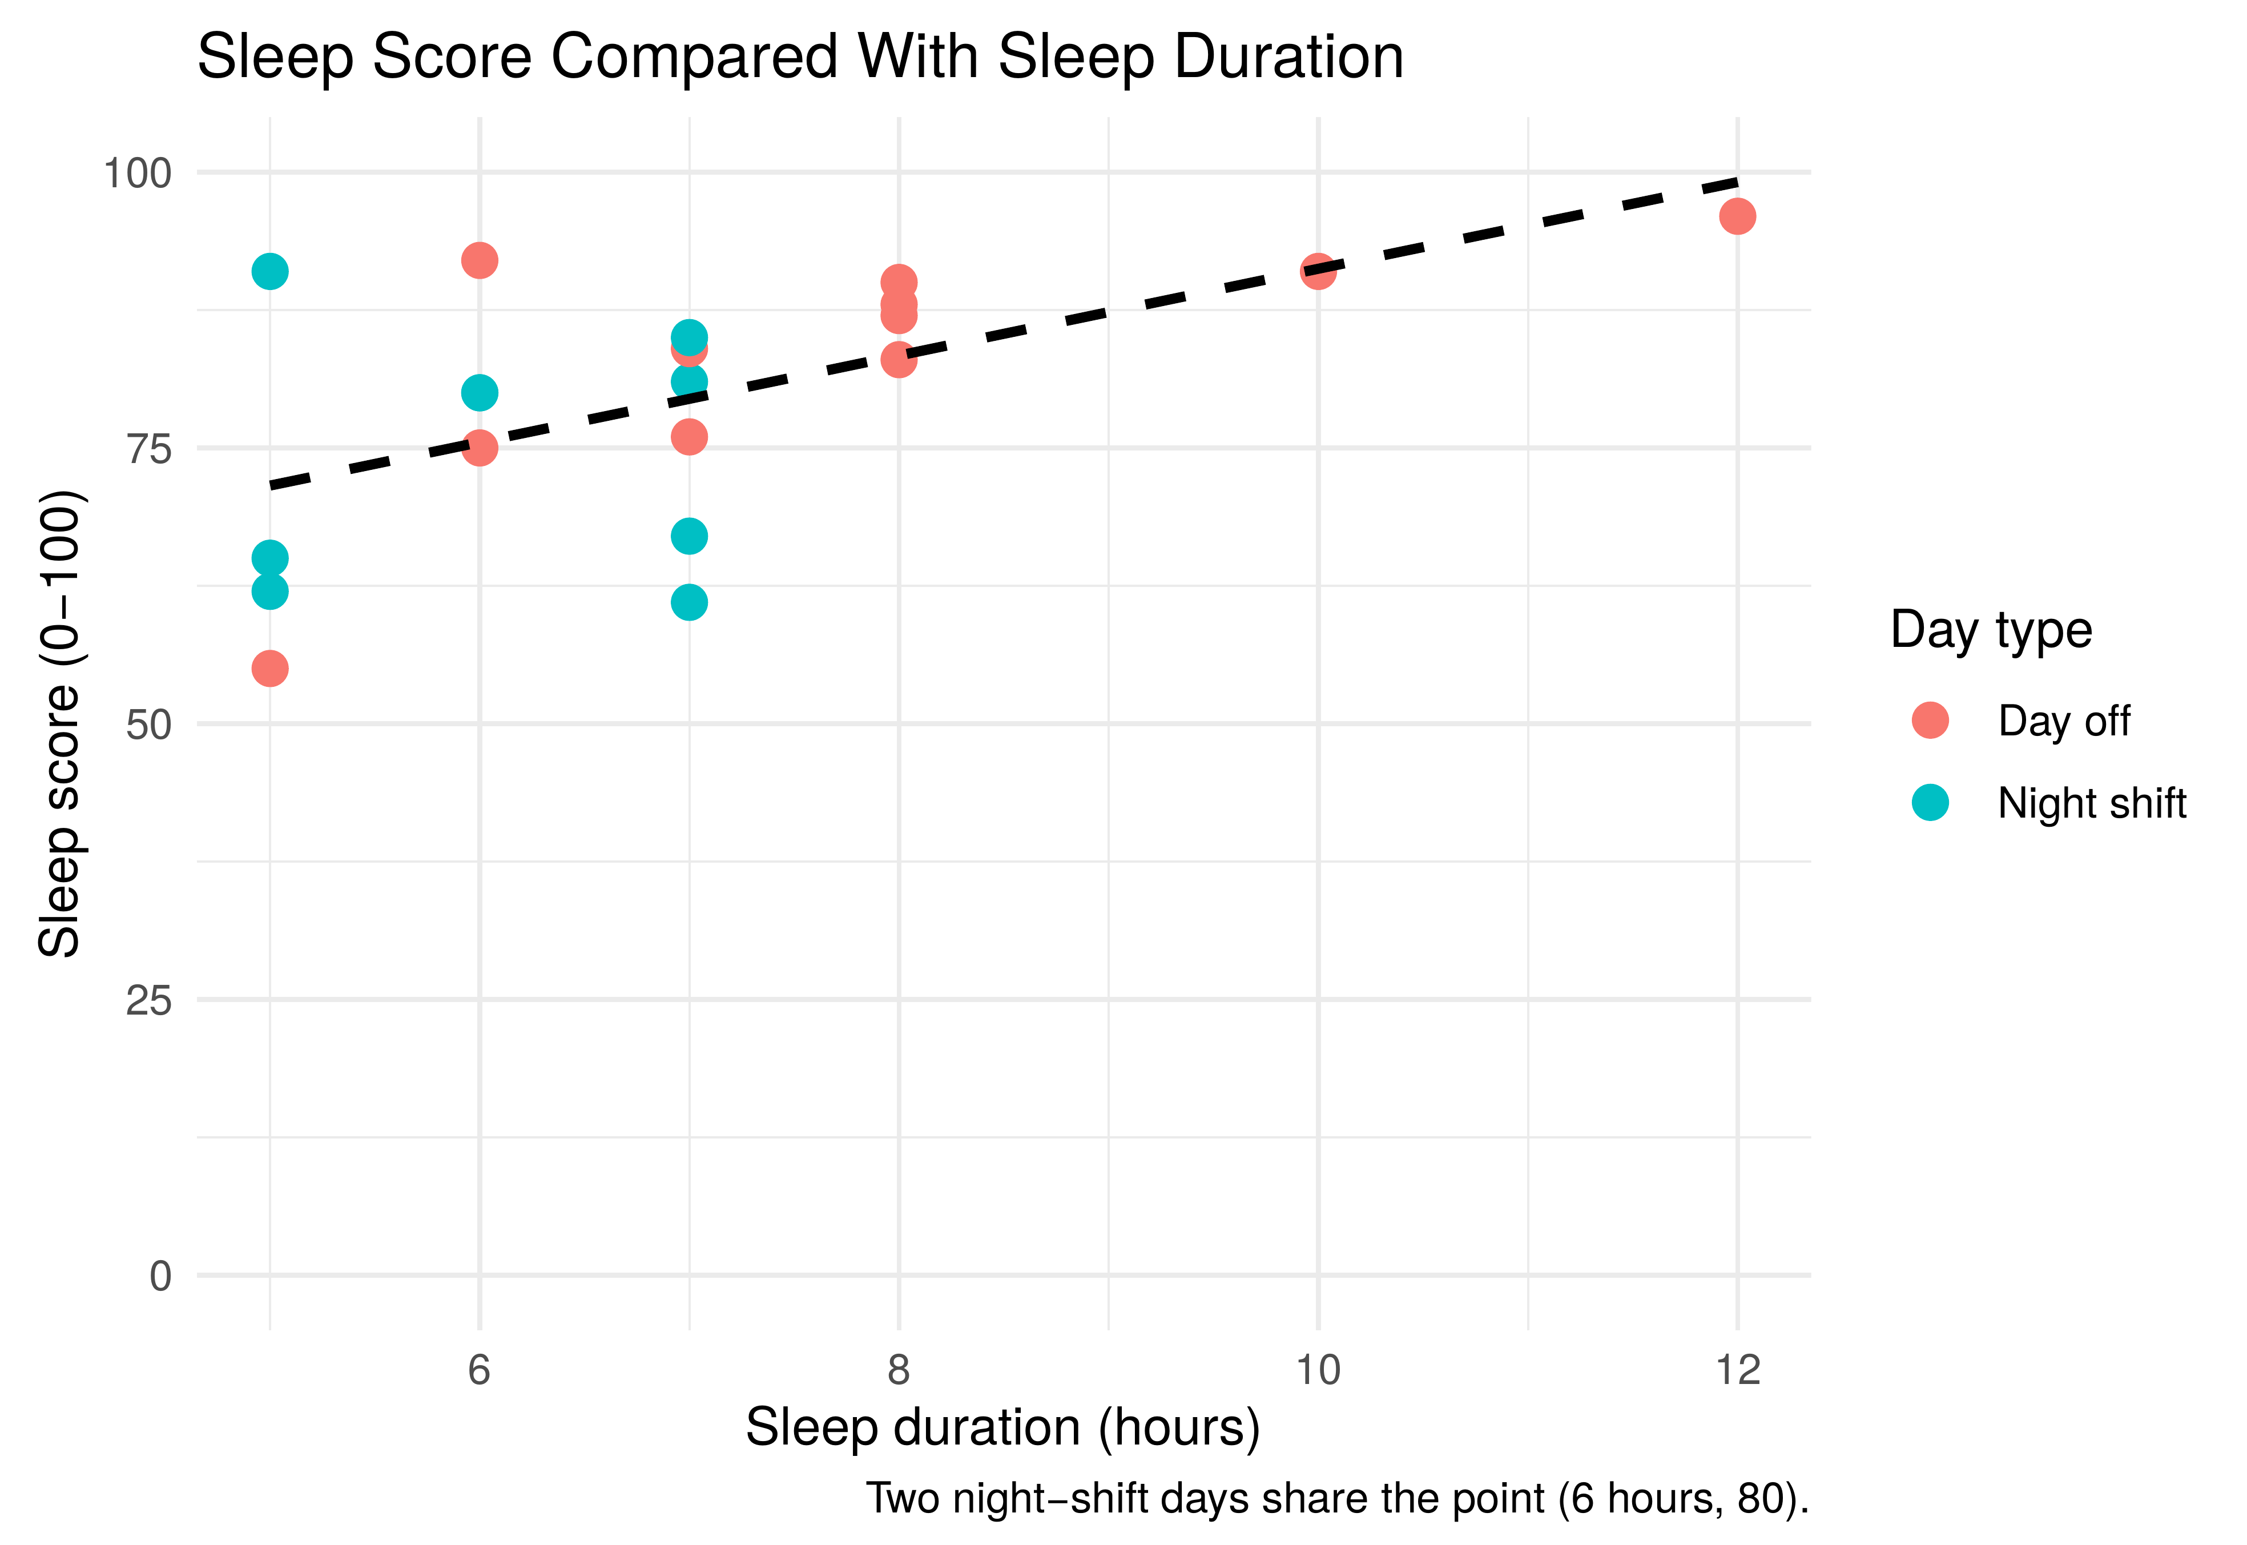
Sleep Quality After Night Shifts Versus Days Off
DATA 211 · DATA SCIENCE AND VISUALIZATION · FALL 2026 STUDENT RESEARCH CONFERENCE
Mohamed Askar
Data Science
Metropolitan State University
A 22-day self-tracking study using R and data visualization
github.com/jaabir009/sleep-quality
Research question
Result
Key findings
Is my sleep quality score different after night shifts than on days off?
After night shifts
On days off
Sleep after night shifts scored lower: the median was 80, against 87 on days off.
The gap is sizeable (d = −0.78) but uncertain. The 95% interval runs from 19.3 points lower to 1.9 points higher, so the result is inconclusive, not proof of no difference.
Every sleep after a night shift lasted 5 to 7 hours, and shorter sleeps tended to score lower.
74.7
83.4
mean score, 9 nights
mean score, 11 nights
8.7 points lower after night shifts, but not statistically significant (p = 0.10).
Figure 1. Every recorded score in date order. Scores swing from night to night, and three night shifts in a row (Oct 30 to Nov 1) scored 61 to 67. Gaps mark the two days with no score.
Figure 2. Scores by day type. The median is 87 on days off and 80 after night shifts, but the boxes overlap, and the single lowest score (55) came on a day off.
Figure 3. Score against hours slept, with a fitted line. Longer sleeps tended to score higher. Sleeps after night shifts lasted 5 to 7 hours; days off ranged from 5 to 12.
How I collected the data
Statistical test
Limitations
22 consecutive days: October 19 to November 9, 2026.
One row per day: date, day type (night shift or day off), sleep score (0–100) and hours slept.
Scores recorded from my Fitbit.
A night-shift row is the main sleep after that shift.
November 2 and 6 have no score. I left them blank instead of estimating, which leaves 20 nights.
Cleaned and graphed in R with readxl, dplyr and ggplot2.
H₀: the mean score is the same after night shifts and on days off.
H₁: the two means differ.
One person and only 20 nights, so the test has little power and the result does not generalize.
Back-to-back nights are not independent, which the t-test assumes.
Sleep after night shifts was also shorter, so day type and sleep length cannot be separated.
Welch two-sample t-test, two-sided, α = 0.05. It compares the mean of a numeric score between two separate groups of nights and does not assume equal spread.
Difference (night − off)
95% confidence interval
p-value
−8.70
−19.29 to 1.89
0.101
t statistic
Degrees of freedom
Effect size (d)
Conclusion
Scores analyzed | Nights | Mean | Lowest | Highest
● Night shift | 9 | 74.7 | 61 | 91
● Day off | 11 | 83.4 | 55 | 96
−1.73
17.45
−0.78
My sleep scored about 9 points lower after night shifts, but three weeks of data cannot rule out chance. Shorter sleep after a shift may explain part of the gap. More weeks of tracking would give a firmer answer.
Decision: fail to reject H₀. There is not enough evidence that the mean scores differ.

